Slide 1

Predicting customer buying behaviour
BEDDA Hana
02/08/2023

Slide 2
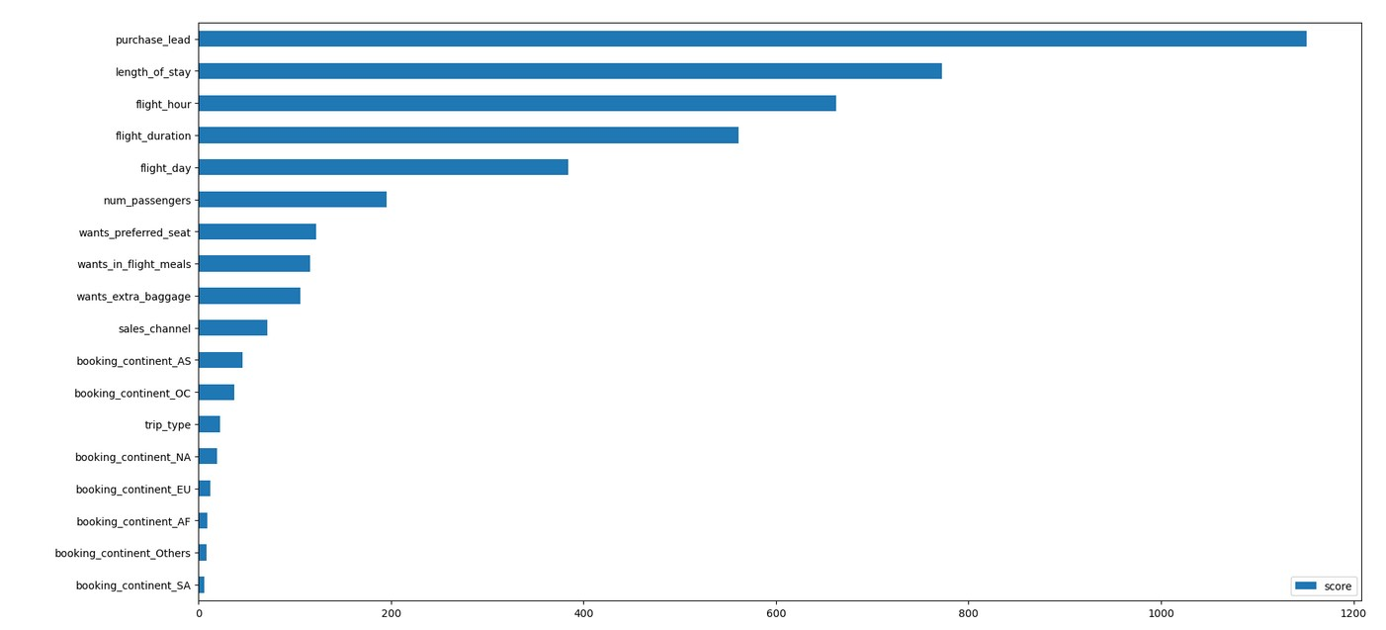
predictive model to understand factors that influence buying behaviour
From our feature importance from our
model, we know that the influencing
factors for customers to complete their
bookings are purchase lead (namely the
time gap between the order time and the
flight) and length of stay (namely how long the
customer will occupy the destination).
Then the area where the customer orders
does not affect whether the customer will
comlete the booking or not.

